Slide 1
Unit 1 Contd
Classes, Objects, Methods, Data Types and Abstract Data Types

Slide 2
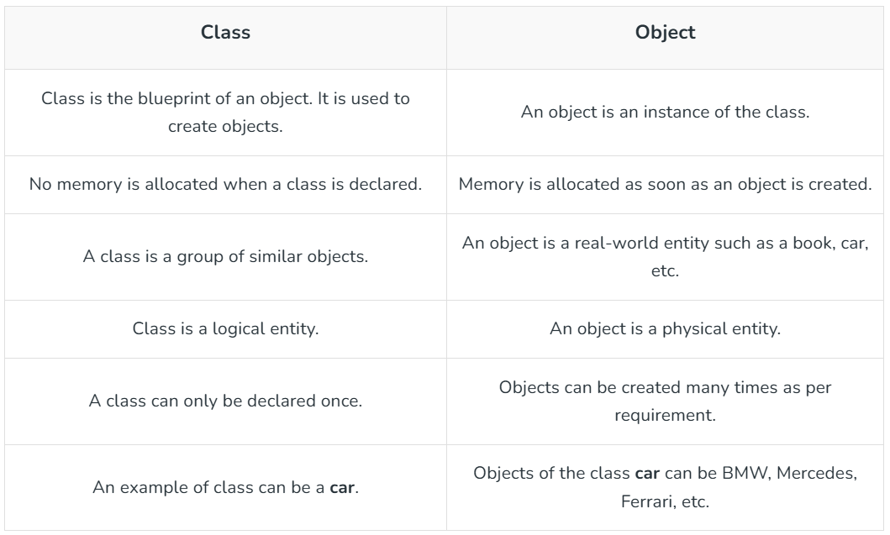
Classes and Objects
In Java, classes and objects are basic concepts of Object Oriented Programming (OOPs) that are used to represent real-world concepts and entities. The class represents a group of objects having similar properties and behavior. For example, the animal type Dog is a class while a particular dog named Tommy is an object of the Dog class. In this article, we will discuss Java classes and objects and how to implement them in our program.

Slide 3
Java Classes: A class in Java is a set of objects which shares common characteristics and common properties. It is a user-defined blueprint or prototype from which objects are created. For example, Student is a class while a particular student named Ravi is an object.
Properties of Java Classes
Class is not a real-world entity. It is just a template or blueprint or prototype from which objects are created.
Class does not occupy memory.
Class is a group of variables of different data types and a group of methods.
A Class in Java can contain:
Data member
Method
Constructor
Nested Class
Interface

Slide 4
Class Declaration in Java
access_modifier class <class_name>
{
data member;
method;
constructor;
nested class;
interface;
}
Components of Java Classes: In general, class declarations can include these components, in order:
Modifiers: A class can be public or has default access
Class keyword: Class keyword is used to create a class.
Class name: The name should begin with an initial letter (capitalized by convention).
Superclass (if any): The name of the class’s parent (superclass), if any, preceded by the keyword extends. A class can only extend (subclass) one parent.
Interfaces(if any): A comma-separated list of interfaces implemented by the class, if any, preceded by the keyword implements. A class can implement more than one interface.
Body: The class body is surrounded by braces, { }.
Constructors are used for initializing new objects. Fields are variables that provide the state of the class and its objects, and methods are used to implement the behavior of the class and its objects. There are various types of classes that are used in real-time applications such as nested classes, anonymous classes and lambda expressions.

Slide 5

// Java Class example
class Student {
// data member (also instance variable)
int id;
// data member (also instance variable)
String n;
public static void main(String args[]) {
// creating an object of
// Student
Student s1 = new Student();
System.out.println(s1.id);
System.out.println(s1.n);
}
}

Slide 6
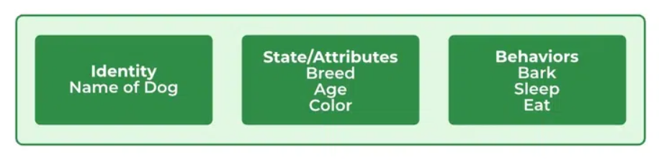
Java Objects: An object in Java is a basic unit of Object-Oriented Programming and represents real-life entities. Objects are the instances of a class that are created to use the attributes and methods of a class. A typical Java program creates many objects, which as you know, interact by invoking methods. An object consists of:
State: It is represented by attributes of an object. It also reflects the properties of an object.
Behavior: It is represented by the methods of an object. It also reflects the response of an object with other objects.
Identity: It gives a unique name to an object and enables one object to interact with other objects.
Objects correspond to things found in the real world. For example, a graphics program may have objects such as “circle”, “square”, and “menu”. An online shopping system might have objects such as “shopping cart”, “customer”, and “product”.

Slide 7
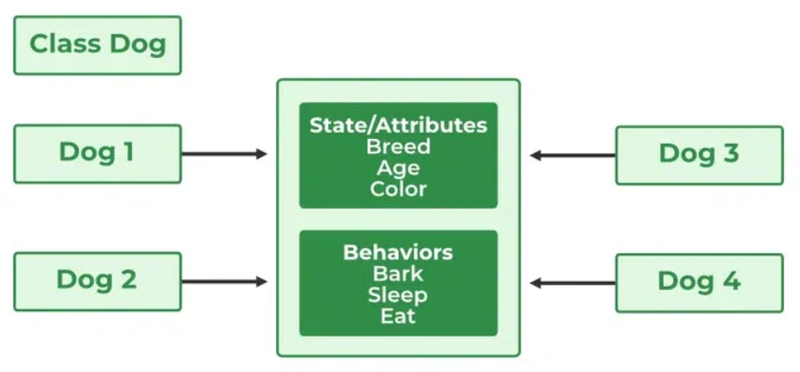
Declaring Objects (Also called instantiating a Class)
When an object of a class is created, the class is said to be instantiated. All the instances share the attributes and the behavior of the class. But the values of those attributes, i.e. the state are unique for each object. A single class may have any number of instances.
Example:
As we declare variables like (type name;). This notifies the compiler that we will use the name to refer to data whose type is type. With a primitive variable, this declaration also reserves the proper amount of memory for the variable. So for reference variables , the type must be strictly a concrete class name. In general, we can’t create objects of an abstract class or an interface.
Dog tuffy;
If we declare a reference variable(tuffy) like this, its value will be undetermined(null) until an object is actually created and assigned to it. Simply declaring a reference variable does not create an object.

Slide 8
Initializing a Java Object
The new operator instantiates a class by allocating memory for a new object and returning a reference to that memory. The new operator also invokes the class constructor.
// Java Program to Demonstrate the use of a class with instance variable Class Declaration
public class Dog {
// Instance Variables
String name;
String breed;
int age;
String color;
// Constructor Declaration of Class
public Dog(String name, String breed, int age,
String color)
{
this.name = name;
this.breed = breed;
this.age = age;
this.color = color;
}

Slide 9
public String getName() { // method 1
return name;
}
public String getBreed() { // method 2
return breed;
}
public int getAge() { // method 3
return age;
}
public String getColor() { // method 4
return color;
}
@Override public String toString()
{
return ("Name is: " + this.getName() + "\nBreed, age, and color are: " + this.getBreed() + "," + this.getAge() + "," + this.getColor());
}
public static void main(String[] args)
{
Dog tuffy = new Dog("tuffy", "papillon", 5, "white");
System.out.println(tuffy.toString());
} }

Slide 10
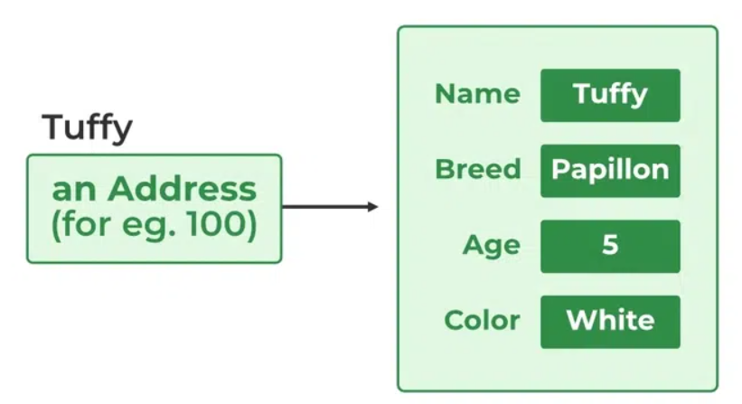
Explanation: Here, the above program demonstrate a class Dog with some instance variables. The constructor is used to initializes value to these variables. The toString() method is used to provide a string representation of the dog object. In the main method, a Dog object named tuffy is created with specific values and its details are printed using the toString() method.
This class contains a single constructor. We can recognize a constructor because its declaration uses the same name as the class and it has no return type. The Java compiler differentiates the constructors based on the number and the type of the arguments. The constructor in the Dog class takes four arguments. The following statement provides “tuffy”, “papillon”,5, and “white” as values for those arguments:
Dog tuffy = new Dog(“tuffy”,”papillon”,5, “white”);
The result of executing this statement can be illustrated as :

Slide 11
Constructors
Java constructors or constructors in Java is a terminology used to construct something in our programs. A constructor in Java is a special method that is used to initialize objects. The constructor is called when an object of a class is created. It can be used to set initial values for object attributes.
What are Constructors in Java?
In Java, a Constructor is a block of codes similar to the method. It is called when an instance of the class is created. At the time of calling the constructor, memory for the object is allocated in the memory. It is a special type of method that is used to initialize the object. Every time an object is created using the new() keyword, at least one constructor is called.
// Java Program to demonstrate Constructor
import java.io.*;
class Geeks { // Driver Class
Geeks() // Constructor
{
super();
System.out.println("Constructor Called");
}
public static void main(String[] args) // main function
{
Geeks geek = new Geeks();
} }

Slide 12
How Java Constructors are Different From Java Methods?
Constructors must have the same name as the class within which it is defined it is not necessary for the method in Java.
Constructors do not return any type while method(s) have the return type or void if does not return any value.
Constructors are called only once at the time of Object creation while method(s) can be called any number of times.
Syntax:
The first line of a constructor is a call to super() or this(), (a call to a constructor of a super-class or an overloaded constructor), if you don’t type in the call to super in your constructor the compiler will provide you with a non-argument call to super at the first line of your code, the super constructor must be called to create an object:
If you think your class is not a subclass it actually is, every class in Java is the subclass of a class object even if you don’t say extends object in your class definition.
class Test { ....... // A Constructor Test() { } ....... } // We can create an object of the above class using the below statement. This statement calls above constructor. Test obj = new Test();

Slide 13
Need of Constructors in Java
Think of a Box. If we talk about a box class then it will have some class variables (say length, breadth, and height). But when it comes to creating its object(i.e Box will now exist in the computer’s memory), then can a box be there with no value defined for its dimensions? The answer is No. So constructors are used to assign values to the class variables at the time of object creation, either explicitly done by the programmer or by Java itself (default constructor).
When Java Constructor is called?
Each time an object is created using a new() keyword, at least one constructor (it could be the default constructor) is invoked to assign initial values to the data members of the same class. Rules for writing constructors are as follows:
The constructor(s) of a class must have the same name as the class name in which it resides.
A constructor in Java can not be abstract, final, static, or Synchronized.
Access modifiers can be used in constructor declaration to control its access i.e which other class can call the constructor.
So by far, we have learned constructors are used to initialize the object’s state. Like methods , a constructor also contains a collection of statements(i.e. instructions) that are executed at the time of Object creation.

Slide 14
Types of Constructors in Java
Now is the correct time to discuss the types of the constructor, so primarily there are two types of constructors in Java are mentioned below:
Default Constructor
Parameterized Constructor
1. Default Constructor in Java
A constructor that has no parameters is known as default constructor. A default constructor is invisible. And if we write a constructor with no arguments, the compiler does not create a default constructor. It is taken out. It is being overloaded and called a parameterized constructor. The default constructor changed into the parameterized constructor. But Parameterized constructor can’t change the default constructor. The default constructor can be implicit or explicit.
Implicit Default Constructor: If no constructor is defined in a class, the Java compiler automatically provides a default constructor. This constructor doesn’t take any parameters and initializes the object with default values, such as 0 for numbers, null for objects.
Explicit Default Constructor: If we define a constructor that takes no parameters, it’s called an explicit default constructor. This constructor replaces the one the compiler would normally create automatically. Once you define any constructor (with or without parameters), the compiler no longer provides the default constructor for you.

Slide 15
Example:
// Java Program to demonstrate Default Constructor
import java.io.*;
// Driver class
class Test {
// Default Constructor
Test() {
System.out.println("Default constructor"); }
// Driver function
public static void main(String[] args)
{
Test hello = new Tests();
}
}

Slide 16
2. Parameterized Constructor in Java: A constructor that has parameters is known as parameterized constructor. If we want to initialize fields of the class with our own values, then use a parameterized constructor.
// Java Program for Parameterized Constructor
import java.io.*;
class Geek {
String name; // data members of the class.
int id;
Geek(String name, int id) {
this.name = name;
this.id = id;
} }
class GFG {
public static void main(String[] args)
{
// This would invoke the parameterized constructor.
Geek geek1 = new Geek("Avinash", 68);
System.out.println("GeekName :" + geek1.name + " and GeekId :" + geek1.id);
} }

Slide 17
Destructor
In programming, a destructor is a method called when an object is destroyed, typically to release resources like memory, file handles, or network connections. In languages like C++, destructors are explicitly used to manage resource cleanup. However, Java takes a different approach due to its automatic memory management system powered by garbage collection.
Java does not have explicit destructors like C++ because the garbage collector automatically manages Java’s memory. Garbage collection tracks objects in memory, and when they are no longer referenced, it automatically reclaims the memory.
Although Java does not provide destructors, it used to have a method called finalize() that could be overridden to define cleanup operations before an object is garbage collected. The finalize() method has been deprecated since Java 9 and removed in Java 18 due to its unpredictability and performance overhead. Instead, modern Java programs rely on other mechanisms for resource management, such as AutoCloseable and try-with-resources.

Slide 18
Advantages of Destructors
Automatic Resource Management: By automating the process of freeing up memory and other resources, Java's garbage collector lowers the possibility of memory leaks and improper resource management.
Simplifies Programming: By eliminating the need for developers to manually monitor and release memory, programming becomes simpler and less prone to error.
Enhances Performance: By effectively handling memory allocation and deallocation, automated memory management can aid in performance optimization.
Memory Management in Java
Java’s garbage collector automatically manages the lifecycle of objects.
When no references point to an object, it becomes eligible for garbage collection.
The garbage collector reclaims memory at its discretion, making memory management automated and simplifying development.

Slide 19
Why Java Doesn’t Need Destructors?
In languages like C++, destructors are essential because programmers manually manage memory allocation and deallocation. In contrast, Java developers don’t have to worry about this due to its automatic garbage collection system. Instead of destructors, developers in Java can handle resource management using the try-with-resources statement and AutoCloseable interface, ensuring resources like files, database connections, or sockets are properly closed.
Alternatives to Finalization in Java
AutoCloseable and try-with-resources:
This is the preferred method for managing resources that require cleanup, such as file streams, database connections, or network sockets.
The try-with-resources statement ensures that resources are automatically closed after usage, without relying on the garbage collector's unpredictable behavior.
java.lang.ref.Cleaner Class:
For advanced cleanup tasks where AutoCloseable is not sufficient, Java 9 introduced the Cleaner class as a replacement for finalize().
Cleaner allows you to register cleanup actions that are invoked once the object becomes unreachable, without the issues associated with finalize().

Slide 20
Methods
A method is a block of code which only runs when it is called.
You can pass data, known as parameters, into a method.
Methods are used to perform certain actions, and they are also known as functions.
Why use methods? To reuse code: define the code once, and use it many times.
Create a Method: A method must be declared within a class. It is defined with the name of the method, followed by parentheses (). Java provides some pre-defined methods, such as System.out.println(), but you can also create your own methods to perform certain actions:
public class Main
{
static void myMethod()
{
// code to be executed
}
}
myMethod() is the name of the method
static means that the method belongs to the Main class and not an object of the Main class.
void means that this method does not have a return value.

Slide 21
Call a Method
To call a method in Java, write the method's name followed by two parentheses () and a semicolon;
In the following example, myMethod() is used to print a text (the action), when it is called:
Example
Inside main, call the myMethod() method:
public class Main
{
static void myMethod()
{
System.out.println("I just got executed!");
}
public static void main(String[] args)
{
myMethod();
}
} // Outputs "I just got executed!"

Slide 22
Method Parameters
Parameters and Arguments: Information can be passed to methods as a parameter. Parameters act as variables inside the method.
Parameters are specified after the method name, inside the parentheses. You can add as many parameters as you want, just separate them with a comma.
The following example has a method that takes a String called fname as parameter. When the method is called, we pass along a first name, which is used inside the method to print the full name:
public class Main {
static void myMethod(String fname) {
System.out.println(fname + " Refsnes");
}
public static void main(String[] args) {
myMethod("Liam");
myMethod("Jenny");
myMethod("Anja");
}
}

Slide 23
Multiple Parameters: You can have as many parameters as you like
public class Main {
static void myMethod(String fname, int age) {
System.out.println(fname + " is " + age);
}
public static void main(String[] args) {
myMethod("Liam", 5);
myMethod("Jenny", 8);
myMethod("Anja", 31);
}
}

Slide 24
Return Values
We use the void keyword in all examples, which indicates that the method should not return a value.
If you want the method to return a value, you can use a primitive data type (such as int, char, etc.) instead of void, and use the return keyword inside the method:
public class Main {
static int myMethod(int x) {
return 5 + x;
}
public static void main(String[] args) {
System.out.println(myMethod(3));
}
}

Slide 25
Method Overloading: With method overloading, multiple methods can have the same name with different parameters:
public class Main {
static int plusMethodInt(int x, int y) {
return x + y;
}
static double plusMethodDouble(double x, double y) {
return x + y;
}
public static void main(String[] args) {
int myNum1 = plusMethodInt(8, 5);
double myNum2 = plusMethodDouble(4.3, 6.26);
System.out.println("int: " + myNum1);
System.out.println("double: " + myNum2);
}
}

Slide 26
Methods Scope: Variables declared directly inside a method are available anywhere in the method following the line of code in which they were declared
public class Main {
public static void main(String[] args) {
// Code here cannot use x
int x = 100;
// Code here can use x
System.out.println(x);
}
}
A block of code refers to all of the code between curly braces {}.

Slide 27
Java Recursion
Recursion is the technique of making a function call itself. This technique provides a way to break complicated problems down into simple problems which are easier to solve.
Recursion may be a bit difficult to understand. The best way to figure out how it works is to experiment with it.
Adding two numbers together is easy to do, but adding a range of numbers is more complicated. In the following example, recursion is used to add a range of numbers together by breaking it down into the simple task of adding two numbers:
public class Main {
public static void main(String[] args) {
int result = sum(10);
System.out.println(result);
}
public static int sum(int k) {
if (k > 0) {
return k + sum(k - 1);
} else {
return 0;
}}}

